Slide 1








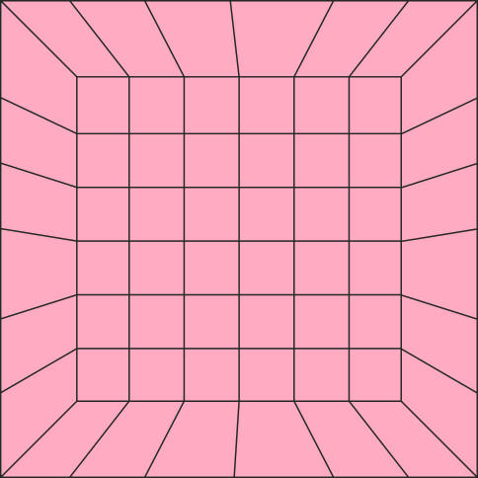







DEMOSTRATION OF SORTING ALGORITHMS
Bubble sort, Quick sort and Insertion sort

Slide 2

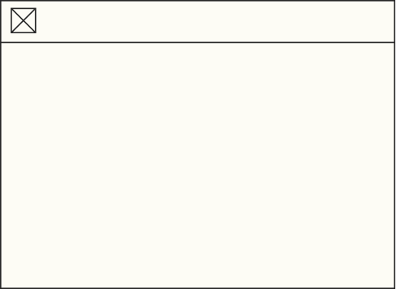


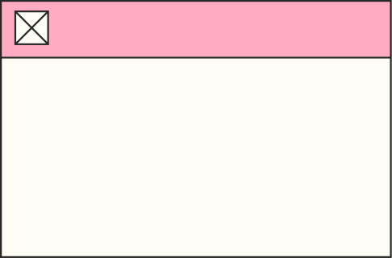


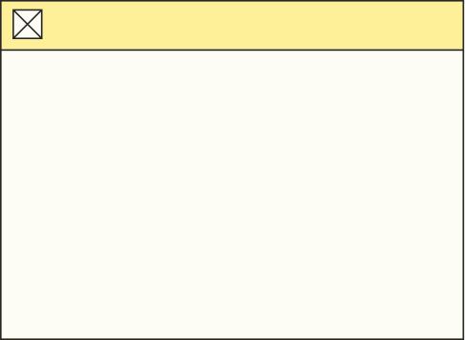
Nguyen Viet Trung - 20214934
-DATACONTROLLER CLASS
-QuickSort class
-Write report
-Make powerpoint presentation
-Combine code
MEMBER AND ASSIGNMET
Pham Quang Trung- 20214935
-MENUSCREENCONTROLLER
-Demonstration Controller
-Combine code
Nguyen Trung Truc- 20214936
-INSERTIONSORT CLASS
-BubbleSort class
-Make demostration video
-Combine code
Phan Dinh Truong- 20214937
-MENUSCREEN.FXML
-Demonstration.fxml
-Combine code

Slide 3

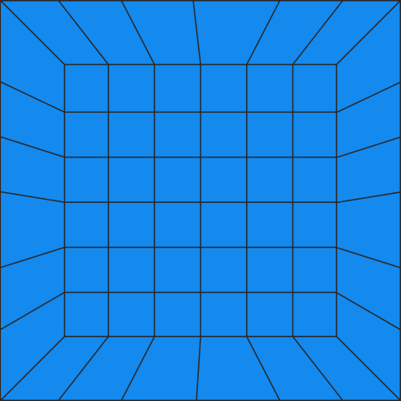



PROBLEM DESCRIPTION
A SORTING ALGORITHM ARRANGES THE ITEMS IN A LIST IN A SPECIFIC ORDER. THE EFFECTIVENESS OF SEVERAL DIFFERENT ALGORITHMS CAN BE INCREASED BY PERFORMING EFFICIENT SORTING. IT IS CHALLENGING TO COMPREHEND AND RECALL EVERY SORTING ALGORITHM THAT HAS BEEN INVENTED TO YET. THE GOAL OF THIS PROJECT IS TO PROVIDE A GRAPHICAL APPLICATION THAT DEMONSTRATES EACH STEP OF THREE FUNDAMENTAL SORTING ALGORITHMS: BUBBLE SORT, INSERTION SORT, AND QUICK SORT. THE GUI WAS MADE USING JAVAFX WHILE THE PROGRAM WAS CONSTRUCTED IN JAVA.
NỘI DUNG ĐOẠN VĂN BẢN CỦA BẠN

Slide 4
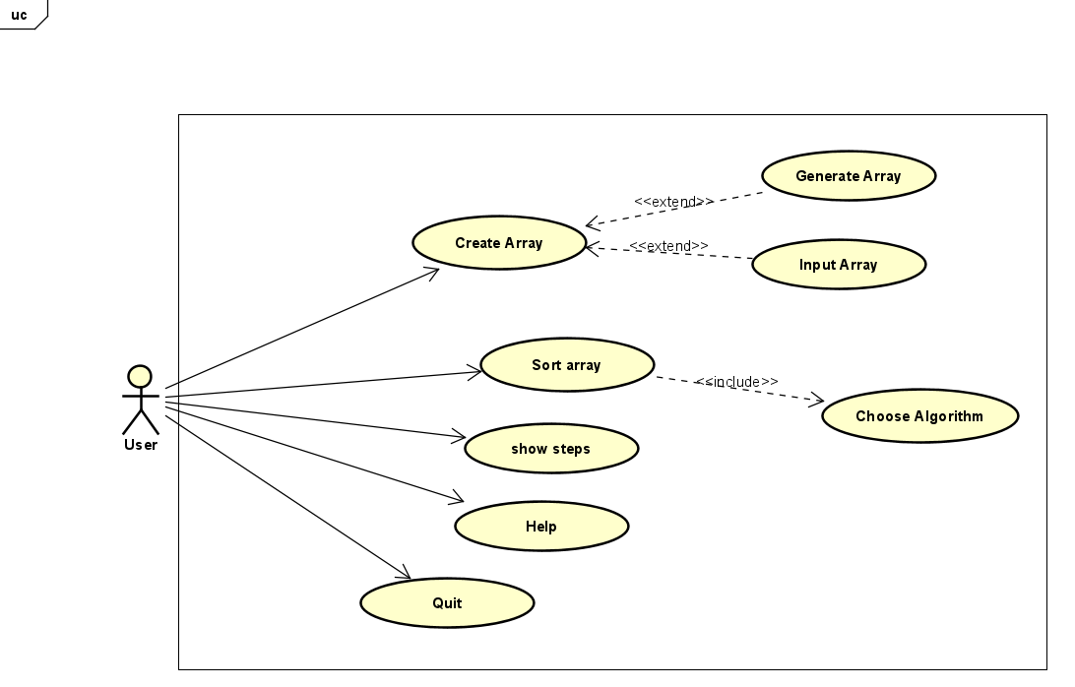
USECASE DIAGRAM
NỘI DUNG ĐOẠN VĂN BẢN CỦA BẠN

Slide 5
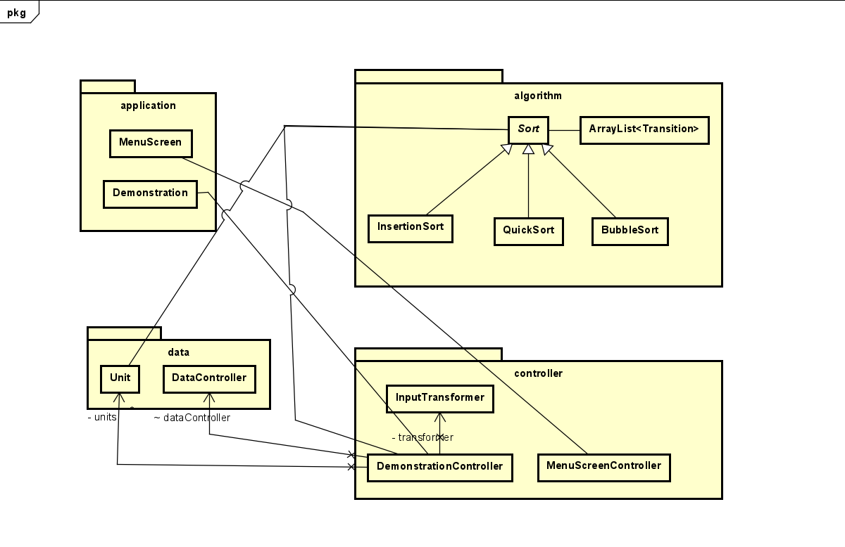
GENERAL CLASS DIAGRAM
NỘI DUNG ĐOẠN VĂN BẢN CỦA BẠN

Slide 6
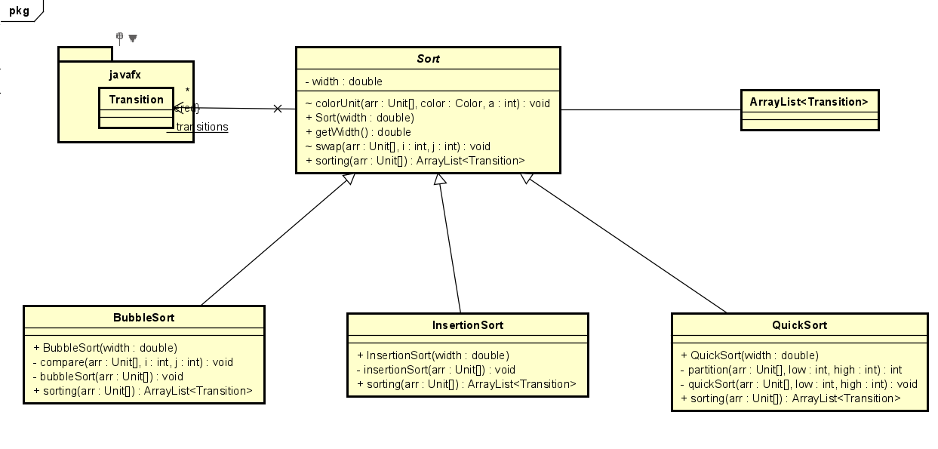
DETAIL CLASS DIAGRAM
NỘI DUNG ĐOẠN VĂN BẢN CỦA BẠN

Slide 7
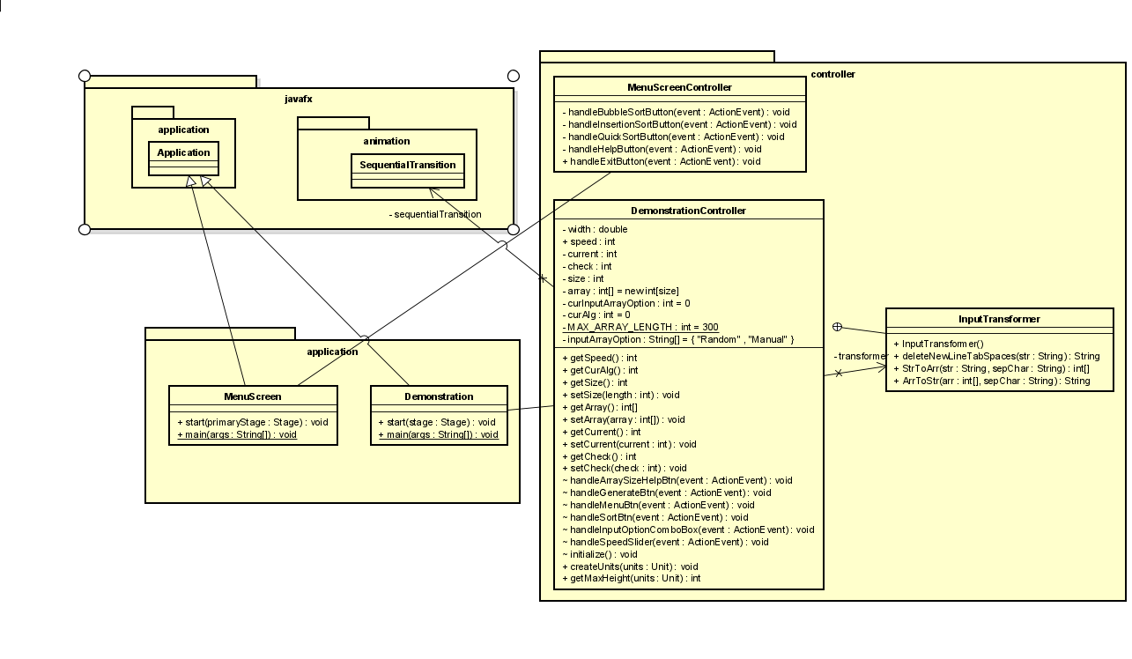
DETAIL CLASS DIAGRAM
NỘI DUNG ĐOẠN VĂN BẢN CỦA BẠN

Slide 8
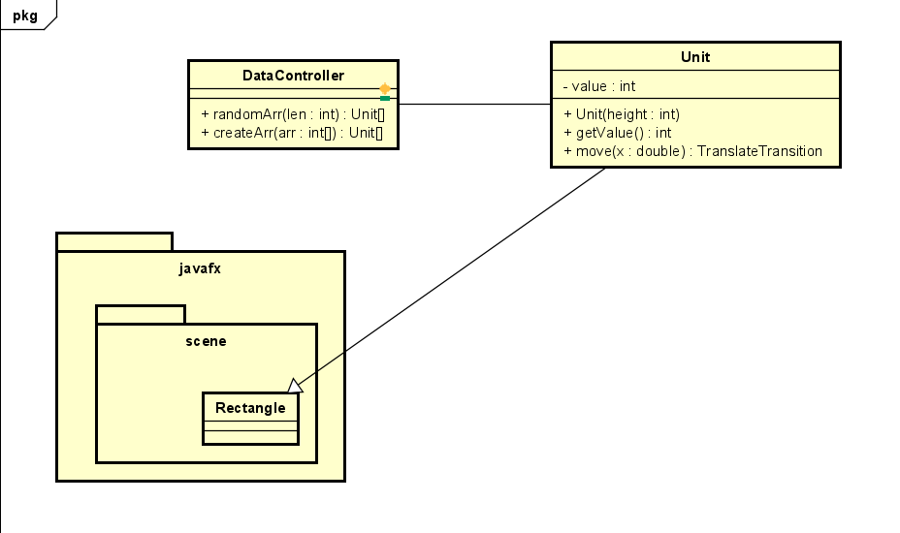
DETAIL CLASS DIAGRAM
NỘI DUNG ĐOẠN VĂN BẢN CỦA BẠN

Slide 9
OOP TECHNIQUES
Inheritance
QuickSort, BubbleSort and InsertionSort inherit from the class Sort
Unit class inherit from the Rectangle class from Javafx
Polymorphism
Sort class used to for all 3 algorithm in DemonstrationController
Association
DemonstrationController associates with Unit, DataController Class, Sort class
NỘI DUNG ĐOẠN VĂN BẢN CỦA BẠN

Slide 10
OOP TECHNIQUES
Association
DemonstrationController associates with Unit, DataController Class, Sort class
MenuScreen associates with MenuController
DemonstrationController and MenuController associate with many javafx class
NỘI DUNG ĐOẠN VĂN BẢN CỦA BẠN

Slide 11


DEMO VIDEO
HTTPS://YOUTU.BE/_M5B8HZRFWE

